Slide 1
Coordinator of officials (COA)
Role
Organize and recruit officials and volunteers for home meets (and sometimes for away meets too to support other clubs)
Update Swimming Canada officials accounts as people get deck evaluations for different positions
Try my best to answer any questions that people have regarding officiating and volunteering in the club

Slide 2
Officiating/volunteering
At registration you paid a volunteer bond that will be refunding upon accumulation of the required volunteer points
Points can be earned at home meets by volunteering or officiating – there is an expectation for all RODS families to volunteer at our home meets. Meets required a lot of volunteers to run and are a great way for our kids to get an opportunity to race and for the club to ear money
You can also earn points officiating at away meets (email the office to let them know you’ve officiated at an away meet), being on the board or a subcommittee, coordinating fundraising opporutnities, etc. There is a full list of the points associated with different positions on the website (members → policies & articles → volunteer chart

Slide 3
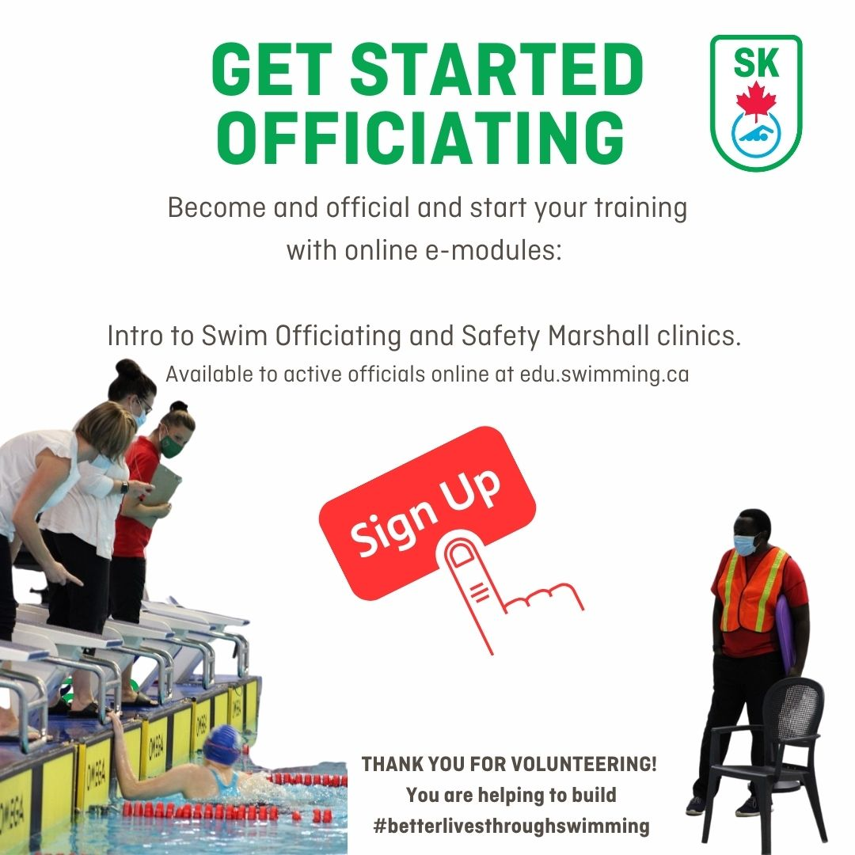
Officials Certification
Encourage all families to not only get certified but to continue along the certification pathway. At our meets we require officials at all levels and ideally we want families from our club to be able to fill these positions.
If you are new to officiating you need to register as an official with swim sask: https://form.jotform.com/222145124834247
For those families who have officiated in the past you need to activate your account with swim sask: https://form.jotform.com/222145124834247

Slide 4
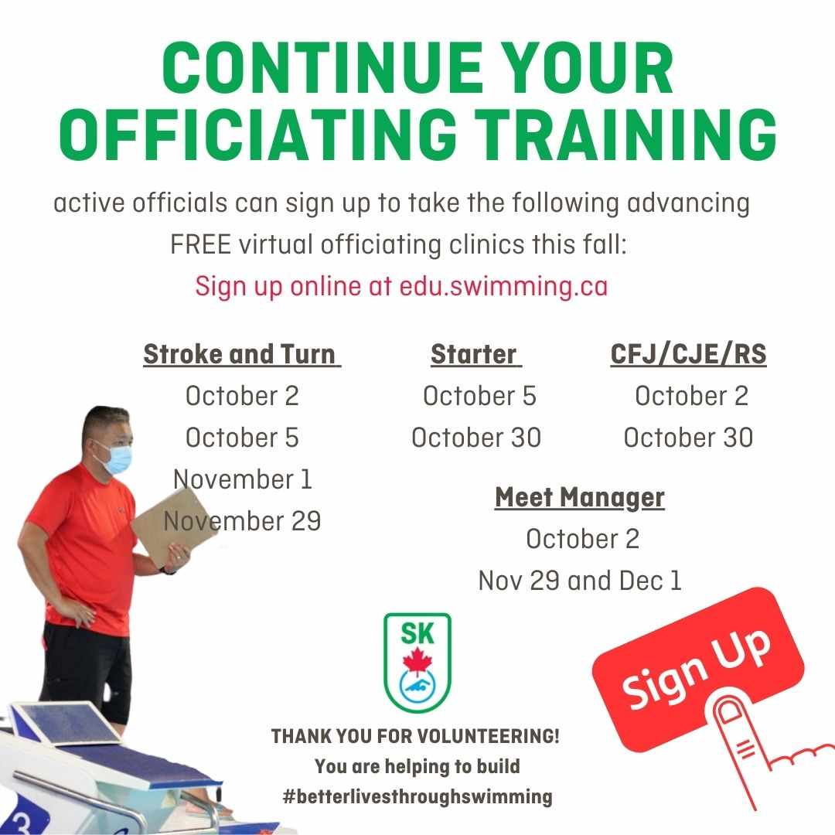
Officials certification

