Slide 1
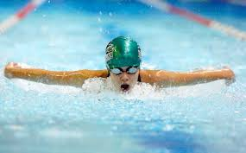
Swim Parent 101

Slide 2
Welcome to the family!
The RODS family is thrilled to have you!
Weekly newsletters will arrive in your email on fridays - they are full of info!
Contact info:
Email: office@reginadolphins.com
Phone: 306-586-3909
Website: www.reginadolphins.com
Parent section of the website

Slide 3
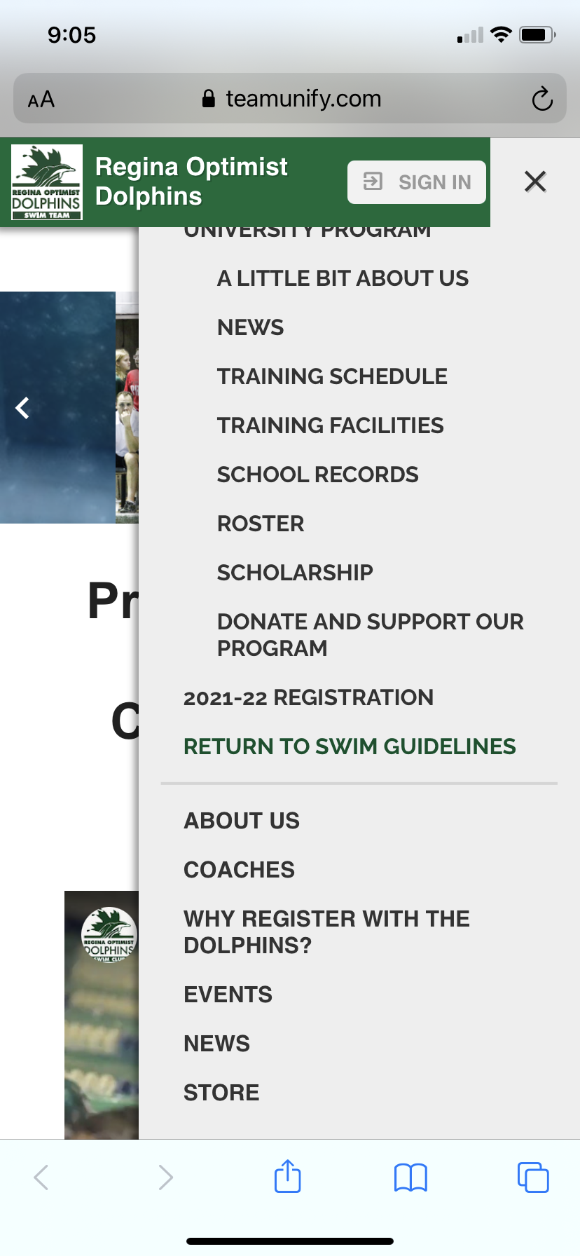
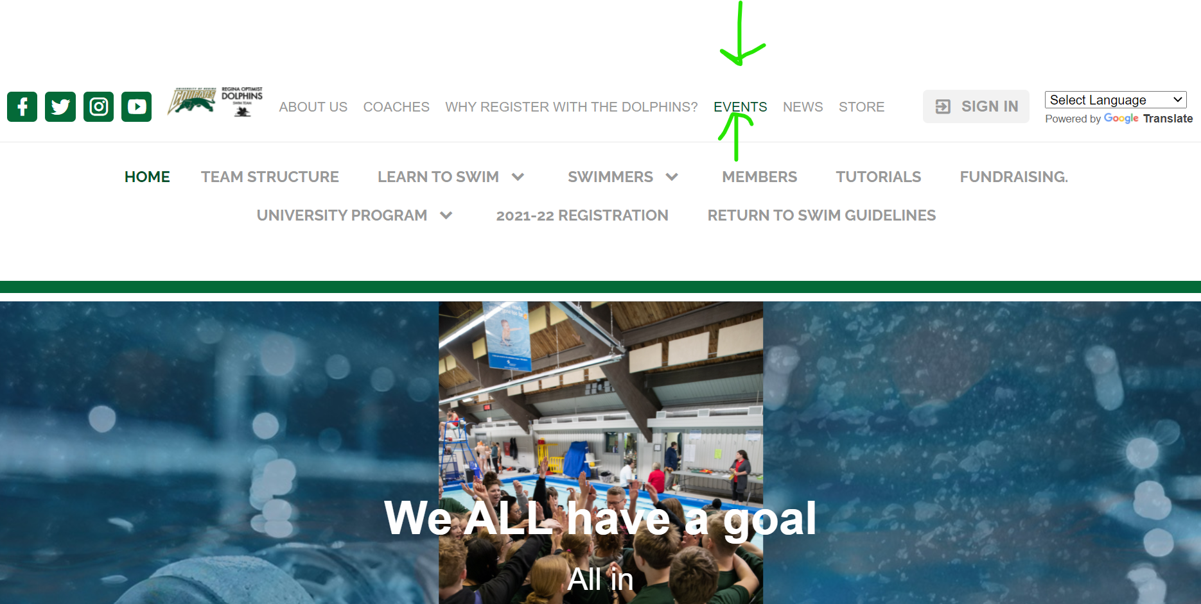
The Events Page: www.reginadolphins.com

Slide 4
Event Page info:
Signing your swimmer up for events
Accepting swim meets
Fundraising
Volunteering
Swim meets (we need you!) & officials training

Slide 5
If you have concerns:
Contact your swimmer’s coach 1st (likely best via email, but can also set up a call or meeting) and plan to be respectful, honest & kind. Solution-focused!
Contact our Head Coach, Craig Nieuwstad nieuwsycraig@gmail.com
Contact our president, Erin Harlos: erindharlos@gmail.com
Of note:
Some of our coaches are young & all are learning. We ask that you are both patient and respectful.
Our board members are volunteers who typically have full time careers, families of their own and lives. We ask that you are both patient and respectful.

